Slide 1
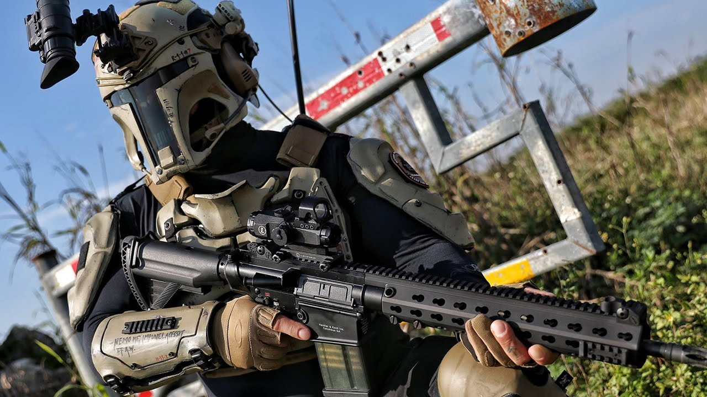
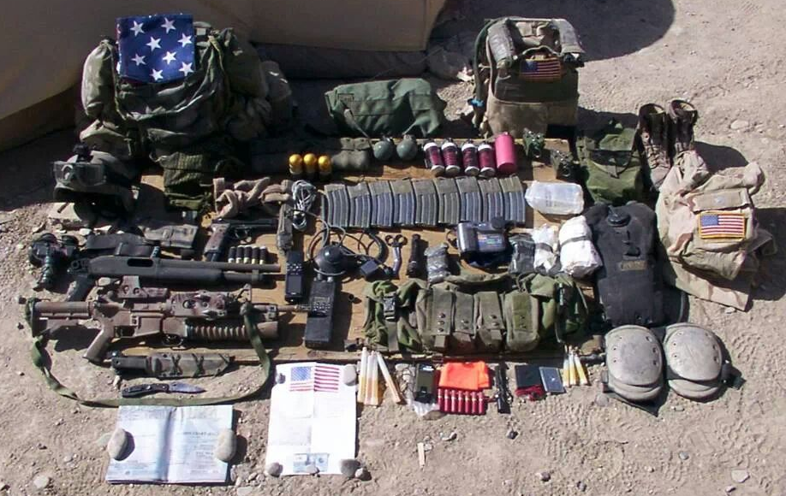
Hacking for Defense (H4DTM)
MBA 590 Special Topics In Business Management Section 005, Spring 2019
Instructors: Lieutenant Colonel Holland, PhD, Army Special Operations Command, Adjunct Associate Professor of Electrical and Computer Engineering, tjhollan@ncsu.edu, Lisa Chang, Director, Technology Entrepreneurship and Commercialization, Nelson Hall.
Advancing technology for unconventional warfare, foreign internal defense, reconnaissance, direct action, and counter-terrorism
H4D is an education initiative sponsored by the U.S. Government and taught at several universities.
NC State’s H4D is aligned with Army Special Operations
H4D Uses “Lean Startup” a proven Entrepreneurial / Innovative method
SOF (Special Operations Force) Operators from Ft. Bragg will be paired with multidisciplinary student teams to solve real SOF problems
Team products will briefed to SOF leaders
You want me to carry that?
An operator’s load

Slide 2
Hacking for Defense - Special Operations Excursion. Do you want to work directly with the world's most elite Warriors to solve 'Battlefield Hard' problems? Are you a driven problem solver who wants to learn the proven innovation techniques of the most successful Startups? If so, Hacking for Defense will push you to the next level and give you the experience to compete and win wherever your career takes you. Student teams will work under the guidance of an active duty Special Operations Forces (SOF) mentor to apply the lessons learned of successful entrepreneurs such as Lean Startup, Business Model Generation and The Four Steps to the Epiphany. Teams will interview over 100 SOF Operators/Stakeholders to generate solutions. The Final Exam is a presentation to SOF leaders - they will be counting on you to a part of the solution to the problems that are currently unsolved. The class meets Mondays from 6PM to 8:45PM. MBA 590 Special Topics In Business Management Section 005, Class# 5358. Expect hard work and a high standard. You will be working with the BEST!
The Army Research Laboratory has agreed to sponsor each student team with $2K to make prototypes for the class as needed.
If you have any questions or even a slight interest feel free to contact the lead instructor, Lieutenant Colonel Holland, PhD, Army Special Operations Command, Adjunct Associate Professor of Electrical and Computer Engineering, tjhollan@ncsu.edu
Or contact Professor Michael Steer, Lampe Distinguished Professor of Electrical and Computer Engineering, mbs@ncsu.edu

